Slide 1
Cruinniú Curaclaim
Curriculum Meeting
Naíscoil agus Bunscoil Bheanna Boirche
Rang 5
Rang Chaoimhe

Slide 2
Clár ama an lae
9.00.9.10am - Registration
9.10-9.30am - Tasc na maidine/Morning Task
9.30-9.50am - Phonics
9.50-10.30am - Gaeilge – Grammar/Comprehension/Writing genre
10.30-11.00am - Breaktime
11.00-11.20am - Mental maths activities
11.20-12.00pm - Numeracy
12.00-1.00pm - Lunch
1.00-1.20pm - Accelerated Reading novels & quizzes
1. 20 -2.00pm – English - grammar & punctuation/work based on novel/ comprehension / writing genre/ writing based on WAU topic/ reading groups
2.00- 2.40pm - W.A.U (topic work)/ Art/ Mindfulness/ Personal Development
2.40-3.00pm - Ceol/ Music
3.00 Hometime

Slide 3
Curriculum
We follow the Northern Ireland Curriculum: Literacy, Numeracy, The World Around us, The Arts (Art and Design, Music and Drama), P.E., Personal Development and Mutual Understanding and ICT.
A significant proportion of the Curriculum in Rang 5 is delivered through Topic-based learning. Children learn to problem solve, investigate ideas, create projects, cooperate with others, explain their findings and extend their vocabulary and communication skills through a variety of Topics. We are currently working on our topic ‘An Ghrianchóras: The Solar System’.
We are very well resourced with ICT equipment, with an interactive whiteboard in our classroom and we have access to 4 computers and 6 ipads when required.

Slide 4
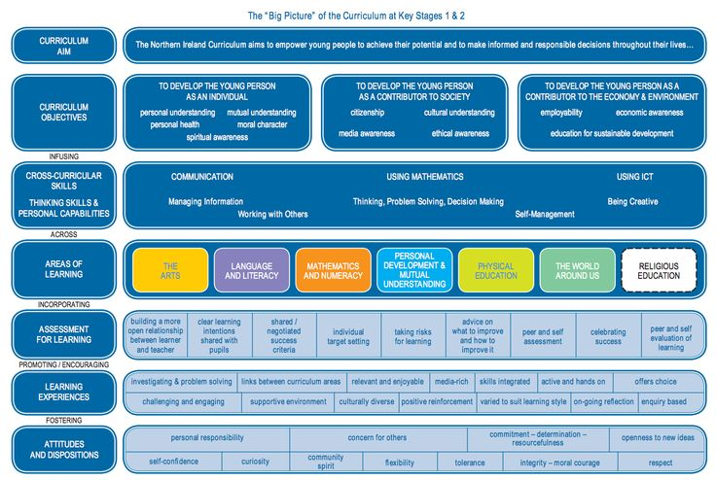

Slide 5
Litearthacht – Literacy
Literacy will be taught through both English and Irish.
Talking and Listening:
This is very important, pupils are expected to listen to others respectfully & speak clearly in their turn. There will be many opportunities to develop their communication skills through class discussions, debates and drama & role-playing relating to topics from across the curriculum.
Reading
Reading will be celebrated both as a form of enjoyment and a vital life skill in Rang a Cúig. Reading homework should be given as much time & attention as written work.
Home readers will be sent home weekly to be read with parents. These are easier books to encourage reading. The children will complete short activities based on these readers for homework, which will help aid their comprehension of what they have read in class.
Children will have access to class library books and a wide range of texts based on our topic (non-fiction books, poetry anthologies, graphic novels etc.) We encourage parents to have their children to join the local library and to engage with their child in positive conversations about the material that they are reading for pleasure.
We use the Accelerated Reading scheme in Rang a Cúig. The children are encouraged to read their Accelerated Reader book at home.

Slide 6
Litearthacht/ Literacy Continued
Phonics and spellings
Phonics play a very important part in reading and spellings, especially in the Irish language, as the children continue to navigate the sounds and spelling system of their second language.
We follow the Cód na Gaeilge program during Fónaic na Gaeilge lessons. The children will investigate a new sound each week and will complete a spelling test every Friday to assess their understanding of this sound.
Writing
The children will be introduced to a new genre of writing each half term (eg, recount, instructional, narrative etc.). We are currently focusing on identifying the features of and writing our own newspaper articles.
In Rang a Cúig, we will place a particular focus on producing high quality pieces of writing. We will focus on the 5 stages of the writing process (collating ideas, planning, drafting, redrafting and editing and publishing) and the children will have plenty of opportunities to share their writing with suitable audiences.

Slide 7
Uimhearthacht- Numeracy
The month of September is spent revising the four main operations: adding, subtracting, multiplying and dividing.
The children will be expected to plan and organise their work, select appropriate equipment, develop their use of mathematical language, analyse their work and present their work and findings clearly.
Throughout Rang a Cúig the children will develop their understanding of number, shape and space and data handling:
Number- Increase competence in dealing with whole numbers and deepen knowledge of place value, recognise pattern and relationships in number, multiplication tables, develop ability in using four main operations and show understanding of maths in real-life problems
Shape and Space – 2D/ 3D shapes- Construct, describe and analyse shapes and awareness of angle, symmetry and co-ordinates
Data Handling- measurement- Length, weight, capacity, volume and time- Ability to convert metric units of measurement and understand the concept of scale. Develop competence in dealing with time, ability to read and understand data stored in a variety of ways, collection and classification, presentation, interpreting of data and probability.

Slide 8
Uimhearthacht- Numeracy
A strong foundation in mental maths will benefit the children greatly as they begin to face more complicated concepts in Rang a Sé. We will spend 20 minutes each day engaging in mental maths games and exercises to consolidate the children’s understanding of number.
These activities will include:
Paired games and group work
Word problems
Number talks/ Dot talks
Open ended maths tasks
Practical games
Drawing and constructing shapes
Investigating 2D/3D shapes
Reading different sources of data
Presenting information and their meanings
Undertaking surveys and collecting their own data

Slide 9
Obair Bhaile - Homework
As you will be aware, we have changed our approach to homework at a whole-school level this academic year. The children will receive one written task a week, alongside 3 other shorter practical tasks. They should still be encouraged to complete their spelling and reading each night. Homework for the week and weekly spellings will be sent home with the children each Monday in their homework folders. The children will return their homework on Friday and this will be returned on the following Monday. Rang 5 should bring their homework folder with them each day, ensuring that their reading books, AR book and homework booklets are inside.

Slide 10
An Domhan Thart Orainn/ The World Around Us
In Rang a Cúig, we will be focusing on five main topics during ‘An Domhan Thart Orainn’ lessons. Cross-curricular learning will take place during these lessons, allowing the children to develop their language skills and mathematical skills in a fun and engaging manner.
We will be exploring the following topics throughout the year:
The Solar System
Native Animals of Ireland
Natural Disasters
Our Culture (The history of the Irish Language, the history of our music, sporting and dancing traditions in Ireland etc.)
The Egyptians

Slide 11
Physical Education/ Corpoideachas
Physical Education; Structured weekly PE lessons are taught, in which teachers follow a movement and athletics scheme which ensures continuity and progression of core skills and competences. These include:
Co-ordination
Balance
Self control
Body awareness
Handling equipment
Spatial awareness
Co-operation
Instructions
Direction
Speed
Accuracy.

Slide 12
Na hEalaíona/ The Arts
Drama | Music | Art
Role-play Topic-based drama activities Imaginative play Use / designing of props | Traditional Irish songs Modern Irish songs Topic-based songs Songs from other countries | Line, shape, colour, pattern, etc Drawing, sketching, painting, cutting, designing, etc Studying famous artists and their work

Slide 13
Measúnú- Assessment
How is my child assessed at school?
Bunscoil Bheanna Boirche assesses pupils in the same ways as pupils are assessed in any other primary school in Northern Ireland- Irish or English Medium.
In accordance with the NI Curriculum, in Years 1-7, teachers must assess your child’s learning.
Continuous assessment is done regularly in the classroom, through assessing your child’s written work, participation in class discussions and tests on a Friday. However in Rang 5 pupils undergo standardised tests in the summer term in English, Irish and Maths which give a more formal indication of progress. These scores are then analysed by the teachers, and used to plan the future teaching and learning of our pupils.
Parent-teacher meetings will help update you on your child’s progress and will give you the opportunity to learn about how you can help your child in the home environment.
At the end of each school year, you will receive a written report from your child’s teacher. This will describe your child’s progress in every aspect of the curriculum.

Slide 14
Imeachtaí Seach- Churaclaim- Extra Curricular activities
Club Bricfeasta- Breakfast club from 8-8.45am
Club iarscoile- The ‘After-School Club’ takes place on a Monday- Thursday after school - 3pm-4pm.
The club will offer a range of different activities for the children ie. gardening, use of ICT, games, homework, baking etc. The cost for both clubs is £3.

Slide 15
Tuismitheoirí- Parents/Guardians
Our caring, family ethos at Bunscoil Bheanna Boirche means that we strongly value the importance of parental input in their child’s education.
We believe that happy children are more effective learners. Parents are always encouraged to discuss any concerns they may have either with the class teacher or with the principal. Our door is always open, and we pride ourselves here at Bunscoil Bheanna Boirche in our open and friendly relationships between teachers and parents.

Slide 16
Ag cuidiú le do pháiste- Supporting your child
A great way to help your child is to encourage them to develop their own independence. In Rang a Cúig, the children should be taking responsibility for their own possessions and ownership of their own learning journey.
You can do the following to help your child:
Ensure that they are wearing the appropriate PE gear on their PE days (Tuesdays and Wednesdays)
Encourage them to look after their own belongings (coats, jumpers etc.) Please label these.
Encourage them to take home and return their homework folders
Take an interest in their work: ask them about their homework, reading books/novels or about what topics they are studying in school
Encourage a healthy diet and lifestyle. (The school has a healthy break policy in line with the SOS programme – only fruit, vegetables, milk or water is permitted.
There are some fantastic websites to assist parents with their child’s learning at home. These include;
www.tearma.ie
www.focloir.ie
www.topmarks.com
www.sumdog.com
Seomra nuachta (through C2k)

Slide 17
Tréadchúram/ Pastoral Care
Your child’s emotional well-being is as important to us as their academic development. We in the Rang 5 classroom of Bunscoil Bheanna Boirche will be partaking in many activities/events to cover this area e.g.
· Reward/Merit system - Dojos (linked to class rules)
-Whole class rewards
- Individual – Dalta & Gaeilgeoir na Seachtaine, Dalta agus Gaeilgeoir na Míosa, etc.
· Circle Time; discussions and role plays on friendships, emotions, bullying, sharing, empathy, etc
· “Maireachtáil foghlaim le chéile” & NSPCC “Keeping Safe” cover many areas of growing up, our families, relationships, respecting ourselves & others, etc
·

Slide 18
Go raibh míle maith agaibh

