Slide 1
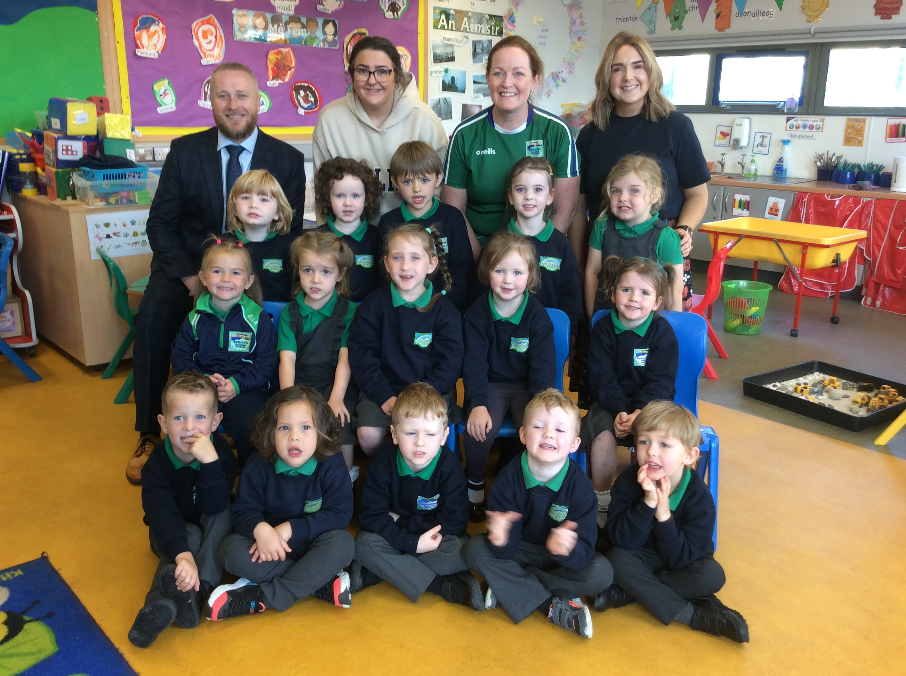
Fáilte go Rang 1!

Slide 2
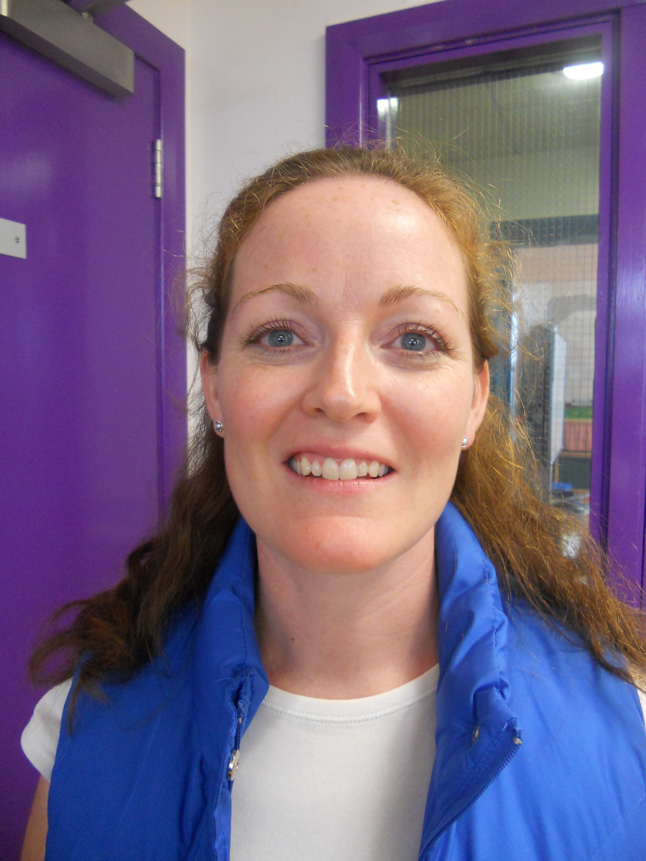
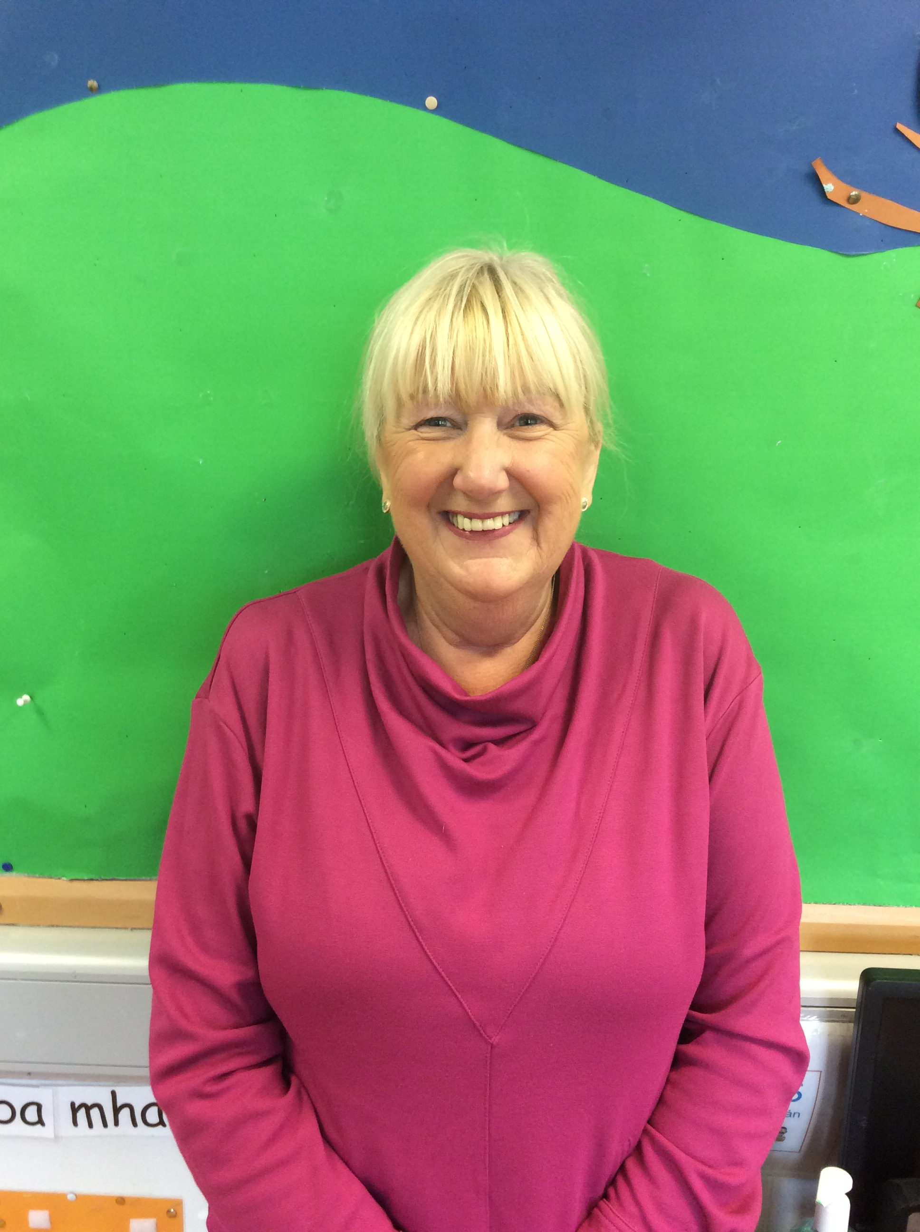
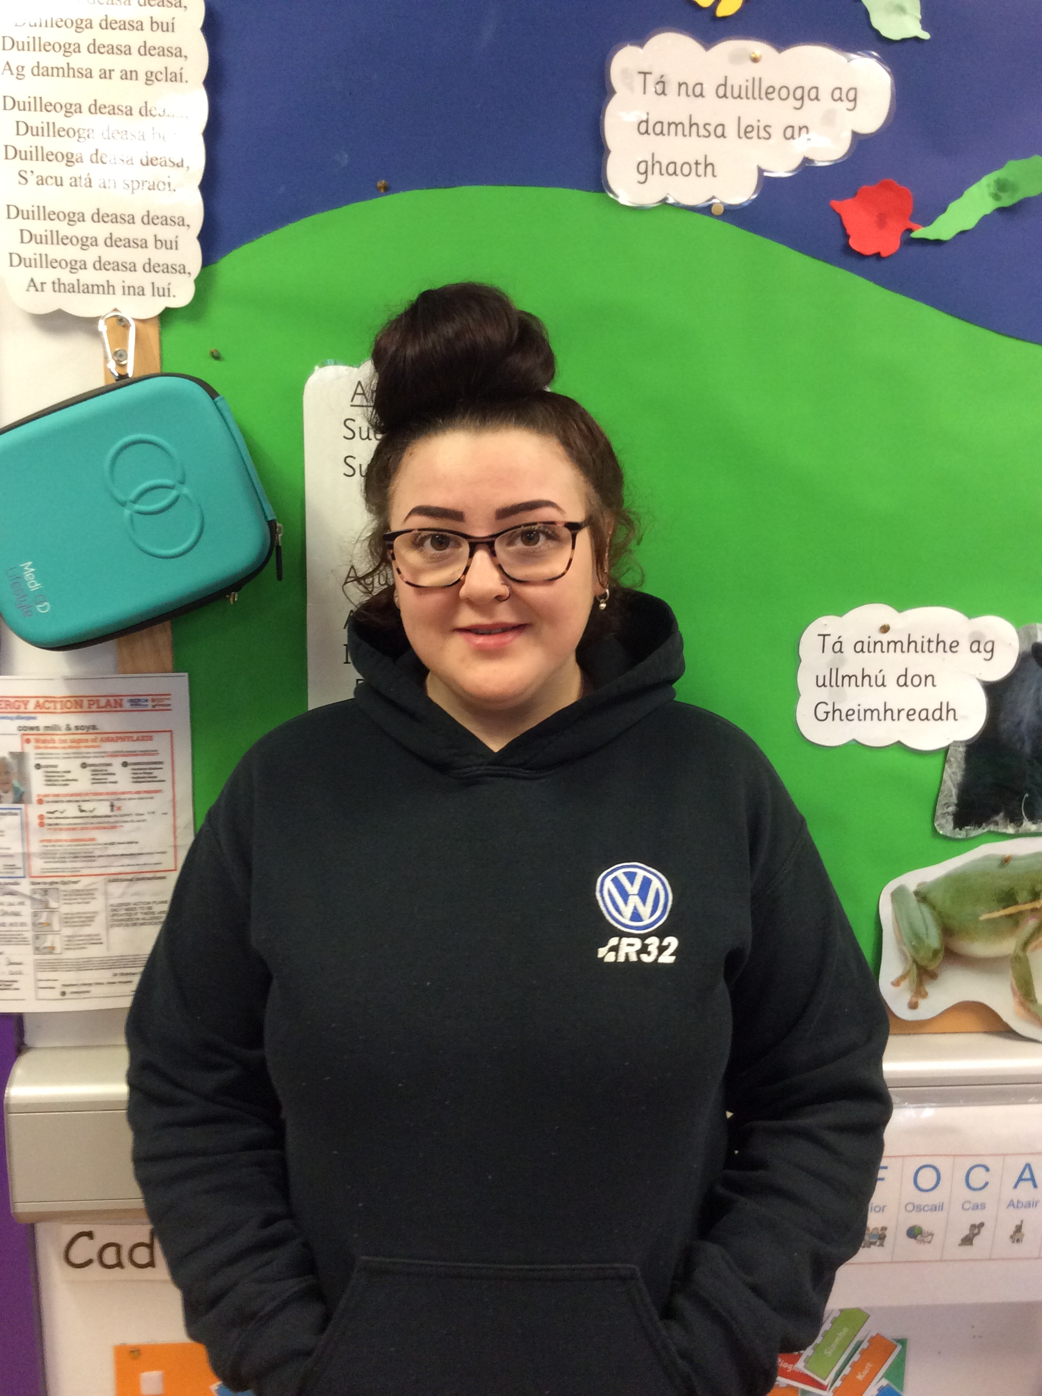
Foireann na Scoile
School Staff
Múinteoir Rang 1 / P1 Teacher - Máire Boden
Cúntóir Rang 1 / P1 Assistant – Martina Lenaghan
Cúntóir Rang 1 / P1 Assistant – Beth Lawlor
Cúntóir Rang 1 / P1 Assistant – Jade Laverty

Slide 3
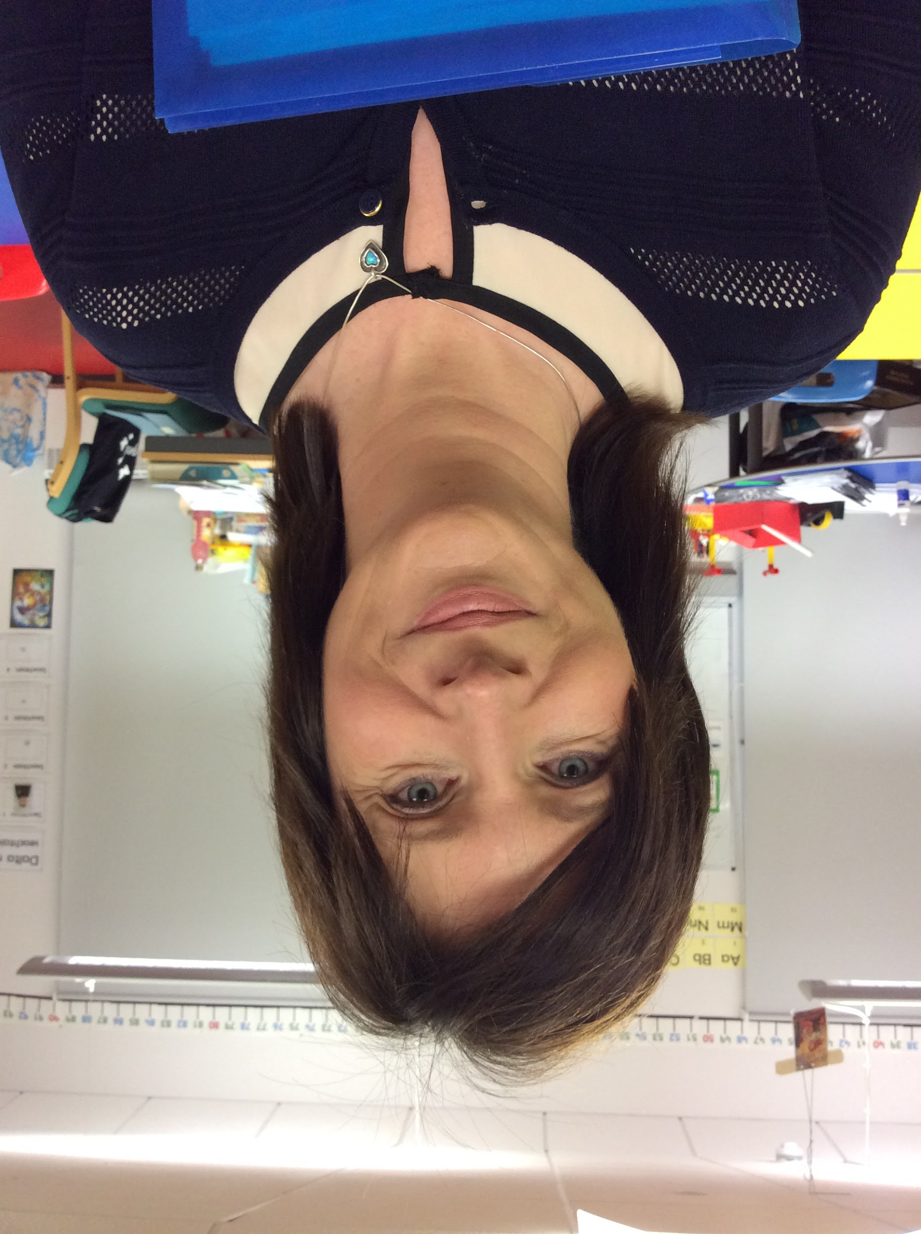
Foireann na Scoile
School Staff
Príomhoide/Principal – Ciarán Mac an tSionnaigh
Rúnaí na scoile/School Secretary - Mary Gallagher

Slide 4
Curaclam
Curriculum
There are three key stages in Primary School:
Foundation Stage (Rang 1 and 2)
Key Stage 1 (Rang 3 and 4)
Key Stage 2 (Rang 5, 6 and 7)
We follow the same Northern Ireland Curriculum as any other primary school in NI: Literacy, Numeracy, The World Around Us, The Arts (Art & Design, Music and Drama), P.E., Personal Development and Mutual Understanding (PDMU), Religious Education and ICT.

Slide 5
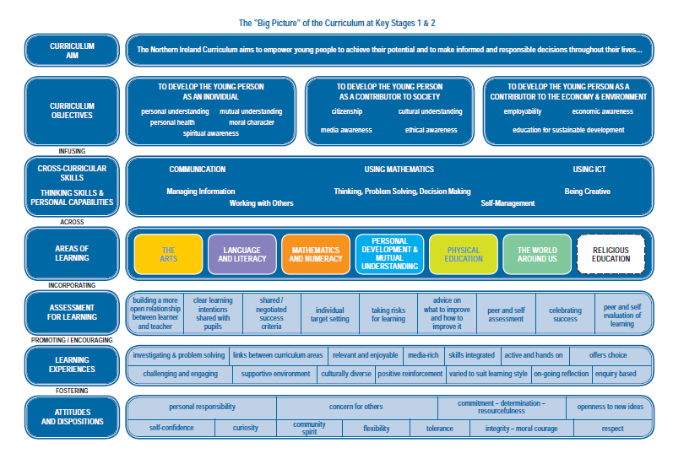

Slide 6
Curaclam (ar lean…) Curriculum (continued…)
A majority of the curriculum in Rang 1 is delivered through play-based learning. Children learn to problem solve, take turns, share, explain their methods and extend their vocabulary and communication skills through language rich, adult supervised/led play experiences. We cover real-life topics such as ‘The Post Office’, ‘At The Vet’ and ‘Hot and Cold’, as well as covering seasons, festivals and celebrations throughout the world. If we have any parents/family members who work in a vets/Post Office/hospital/café/farm or garden centre, we’d love to arrange a visit during the year!
We are very well resourced with ICT equipment, with an average of 2 PCs, 1 laptop, an interactive board and a set of iPads in each classroom. We were awarded ‘Digital-School’ status in June 2017, and we came first place in the Primary School section of the Northern Ireland C2K ICT Excellence Awards in June 2024.
We are an inter-denominational school, and we follow ‘Living Learning Together’, a pastoral care programme which encourages personal development and mutual understanding of the world and the wider community. We also prepare children for the Catholic sacraments if their parents so wish, following the Veritas ‘Beo Go Deo’ Catholic Education Series.

Slide 7
Litearthacht
Literacy
The biggest question parents have about our curriculum is the
teaching of Language and Literacy.
In Rang 1 we teach the same language concepts and literacy skills taught in any other Primary 1 classroom in Northern Ireland, i.e. Talking & Listening Skills, Beginning Sounds, Rhyme, Syllables and Blending, we just happen to use Irish words as samples, rather than English, such as ‘madadh’ and ‘muc’ instead of ‘mouse’ and ‘monkey’ or ‘lón’ rhymes with ‘rón’ etc…
We teach phonics, usually looking at a sound a week, and we send home weekly keywords to help pupils with emergent reading
We teach reading skills, such as turning pages, reading from left to right, and using pictorial clues to help tell the story
We teach writing skills, starting off with individual letters/sounds, building up to words and their own names, and progressing to sentence level towards the end of the year
Pupils are taught English lessons from Rang 3 onwards, but have the foundation literacy skills from Rang 1 and 2 already, and so aren’t starting ‘from scratch’ at all.

Slide 8
Measúnú
Assessment
Another key question parents often ask is ‘how will my child be assessed?’
Bunscoil Bheanna Boirche assesses pupils in the same ways as pupils are assessed in any other primary school in Northern Ireland – Irish or English medium.
In accordance with the NI Curriculum, in Years 1 – 7, teachers must assess your child’s learning.
In Rang 1 & 2, this predominantly takes the form of ongoing individual classroom observations. In Rang 1 & 2, rather than sitting end of year tests, pupils are assessed on a 6 – weekly basis on their key literacy and numeracy skills/targets, albeit in a very informal style, such as structured games and 1:1 activities.
In Rang 3 - 7, pupils undergo standardised tests in the summer term in English, Irish and Maths, which give a more formal indication of progress. These scores are then analysed by the teachers, and used to plan the future teaching and learning of our pupils.
Every year, 1:1 parent-teacher meetings are held to update you on your child’s progress and to suggest areas to help support your child in the home environment.
At the end of each school year, you will receive a written report from your child’s teacher. This will describe your child’s progress in every aspect of the curriculum.

Slide 9
Spóirt
Sports
At Bunscoil Bheanna Boirche, pupils have the opportunity to experience a wide range of sports.
Structured weekly PE lessons are taught, in which teachers follow a movement and athletics scheme which ensures continuity and progression of core skills and competences.
Sports and games included in after-school club activities
Key Stage 2 pupils play Gaelic football, hurling and soccer for the school in local inter-school competitions.
Key Stage 2 pupils travel to Down Leisure Centre in Downpatrick every spring term for swimming lessons.
Key Stage 2 pupils participate in the Cycling Proficiency Programme.

Slide 10
Imeachtaí Seach-churaclaim Extra-curricular activities
Club Bricfeasta – breakfast club from 8 – 8.45 am at £3 per morning
After-School Club 2-4pm (2 – 3pm Rang 1 – 3, 3 – 4pm Rang 4 – 7) daily for £3 per session
After-school sports coaching
After-school guitar lessons
School Council
Eco-School committee
Summer Scheme - having fun and speaking Irish in July
Regular school trips, walks and outings
Forest school activities in Bunkers Hill
Inter-school sports and quiz competitions
Scoildrámaíocht competitions
Poetry and conversation Feiseanna

Slide 11
An Lá Scoile The School Day
Class begins at 9 am. Children are supervised in the clós (playground) from 8.45am, and parents can avail of our ‘Club Bricfeasta’ which is available each morning from 8 – 8.45 am, at a cost of £3 daily.
Breaktime is from 10.30-11.00am.
Lunchtime is from 12-1.00pm.
At Bunscoil Bheanna Boirche, we pride ourselves on our healthy eating policy. It is recommended that pupils eat a small snack, ideally fruit, a yogurt or a small roll/sandwich at breaktime. Water is always available also. We don’t allow sugary/fizzy drinks, crisps, chocolates and sweets, and strongly recommend your child has a reusable water bottle for their drinks, rather than single-use or hard to open drinks bottles.
We do not have any children with a nut allergy in our class at present but we discourage bringing nuts to school. We also ask that parents don’t send in buns or cakes on occasions such as birthdays etc. We also ask you to reiterate with your child about not sharing their food, as kind as they may think they’re being!

Slide 12
An Lá Scoile ar lean… The School Day continued…
Our school dinners come from St. Malachy’s Primary School in Castlewellan, and the menu is available to view on our school website every term. Please ensure your child knows what they will be eating every day.
In addition, especially on days when there is a choice in meals such as Wednesdays (usually a choice between curry and a baguette), that you look at the menu together and your child understands what they would like to order.
Meals currently cost £2.60 per day, payable either in cash (please send money in a clearly labelled envelope, as loose change, especially in Rang 1, is very easily lost) or via the school Parent Pay system. All log in details were sent home mid September. Please contact Máire or the school office if you are having trouble paying online.
Rang 1 and Rang 2 go home at 2.00pm Mon – Thurs and 1.50pm on Fridays to help ease traffic congestion.
Please inform us of any changes in address/phone number/circumstances or if someone different from who is named on your child’s data collection form will be collecting your child.

Slide 13
Poncúlacht agus Tinreamh
Punctuality and Attendance
School begins at 9 am, but pupils are welcome to be dropped off and supervised in the school yard from 8.45am.
On wet mornings, pupils come straight to the classroom from 8.45am.
It is very important for pupils to be in school on time, as they may miss registration, ordering their dinner (which is done first thing), discussing our plan for the day and the beginning of morning lessons. It can also lead to children being reluctant/shy to come in to class, leading to disruption to the whole class.
Children who are late will be marked late on the register.
If your child is absent, you should contact the school office on the first day of absence, then send in a completed absence slip on your child’s return. If this does not happen, the absence goes down as “unexplained absence”.
If you are collecting your child early, you should contact the office before coming to the classroom, unless prearranged with Máire.

Slide 14
Éide Scoile School Uniform
Our uniform consists of:
Navy sweatshirt embroidered with the school logo and motto (available from John McKenny’s Clothes Shop in Castlewellan, Co. Down);
Grey trousers, skirt or shorts;
Green polo shirt embroidered with the school logo and motto;
Navy school coat (optional);
Black shoes (slip on/velcro ideally, so they can take shoes off/on independently);
Navy or green gingham dresses in the summer time;
P.E. uniform (to be worn on Fridays only) consists of:
Grey/ navy track bottoms, or grey/navy shorts;
Suitable trainers
Green polo shirt embroidered with the school logo and motto
We have a school jersey and quarter zip top which is OPTIONAL, which can be ordered from the O’Neills website.
Rang 1 pupils are strongly recommended to wear velcro trainers for PE to enable them to change as independently as possible
Please no club/county/branded sports gear on PE days

Slide 15
Éide Scoile School Uniform
Please ensure that your child comes to school in a suitable waterproof coat, to allow us to be outdoors as much as possible. In Rang 1, coats with zips are preferable, as we need pupils to be able to put on and take off their own coats.
We also ask that you pack a change of underwear, socks and trousers/tracksuit bottoms in your child’s school bag daily (or it can be kept on their coat hanger in the cloakroom) in the case of a toileting accident or a fall in a puddle etc...
PLEASE ENSURE ALL JUMPERS AND COATS ARE CLEARLY LABELLED WITH NAMES. Jumpers especially are frequently taken off, and are easily taken home by another pupil. If it is clearly labelled, it can be returned easily, whereas without a name, it may become lost indefinitely.

Slide 16
Cúrsaí Airgid
Transport, Free School Meals and Uniform Allowance
For those parents who wish to apply for home to school transport assistance, the Education Authority (previously known as the Education and Library Board) has introduced a new, online process for parents applying for home to school transport support. Further information on eligibility for transport assistance and how to apply can be found on the Education Authority website following the link: www.eani.org.uk/financial-help/home-to-school-transport/how-to-apply-for-transport-assistance-for-my-child
If you think you could be eligible for free school meals or school uniform allowance, further information and downloadable forms can be found at: https://www.eani.org.uk/financial-help/free-school-meals-uniform-grants

Slide 17
Aip Scoile
School App
As we are an award winning Eco School, we aim to use as little paper as possible. Therefore, we send out important messages and information via our Schools NI app.
Parents are asked to download it ASAP, if you haven’t done so already. Please select Bunscoil Bheanna Boirche as your favourite school, and ensure that notifications are enabled and that you check the app regularly. We also ask parents to visit our website to keep up to date with what is happening in our school, for the school dinner menu etc...
Our app is available on both Android and Apple devices. Simply visit our school website where you will be prompted to download the app for free. www.bunscoilbb.com

Slide 18
Safer Schools NI App
We strongly recommend every family downloads the Safer Schools NI App, an online platform funded by DENI to support parents ensure internet use at home is safe.
Keeps you up to date with the current online trends, threats, and risks to your child. This information is sent directly to your device!
Delivers the information you need to know on social media and gaming platforms, helping you understand the latest buzzwords and how to set privacy and parental settings on platforms like Among Us, Minecraft and TikTok.
Offers expert guidance to help you navigate important issues such as bullying, mental health and healthy relationships. Giving you practical tips on how to approach these conversations with your children.
The Online Safety section will signpost you to help and support where you need it when you need it – it's in your pocket!

Slide 19
Tuismitheoirí
Parents
Our family ethos at Bunscoil Bheanna Boirche means that we strongly value the importance of parental input in their child’s education, and we enjoy a good level of parental participation and involvement in our school community here at Bunscoil Bheanna Boirche.
We strive to involve parents in the life of the school. Parents help with breakfast club, after-school activities and assist on school trips and events. Parents are employed in the school as lunchtime supervisors and classroom assistants. Parents are also involved in school fundraising, and we have a very active and vibrant Parents’ Support Group who regularly organise fundraising events and activities to help subsidise school trips and equipment.
We believe that happy children are more effective learners. Parents are always encouraged to discuss any concerns they may have either with the class teacher or with the principal. Our door is always open, and we pride ourselves here at Bunscoil Bheanna Boirche on our open and friendly relationships between teachers and parents.
If parents wish to speak to their child’s teacher privately, please ring the school office to arrange a telephone appointment.

Slide 20
Foghlaim sa Bhaile
Home-learning
We use a range of methods to communicate with our parents at BBB, such
as Google Classroom, our Schools NI app and our school website
www.bunscoilbb.com.
Whole-school, general messages are sent via the school app, whereas individual class level messages are sent primarily via each class ‘Google Classroom’. Class teachers set homework, post messages and communicate at a class level using this app, as well as providing individual, personal feedback to pupil on their work/activities.
Log-in details and passwords were sent home at the start of September. Hopefully everyone is now successfully using our ‘Google Classroom’ and are seeing our weekly challenges/tasks as well as messages and notices.
In addition, we highly recommend parents follow Cairde Naíscoil agus Bunscoil Bheanna Boirche on Facebook for regular posts and suggestions regarding home-learning and Irish-language events and activities going on in the community.

Slide 21
Réidh do Rang 1
Ready for Rang 1
Putting on own shoes, jumper, coat
Velcro shoes
All clothes labelled
How to open and close schoolbags, lunchboxes, tupperware, packaging etc…
Colouring in & scissor skills
Reading to/with your child
Recognise own name in writing/print
Don’t practise letter/name-writing yet! This often leads to wrong letter formation habits/writing in capitals, which can be extremely difficult to undo. Leave that to us!
Talking to your child – studies have shown that with increased screen time and tablet use, children’s expressive language skills have plummeted, evidence of which we see ourselves in class unfortunately. Take time to turn off the tablet and screens, and play I Spy, Snakes and Ladders and Snap together, or retell a classic fairytale to each other line by line to help your child improve their oral literacy skills.

Slide 22
Obair bhaile
Obair while-ye
Homework
In Rang 1, we don’t send formal homework home until after the Halloween break, although we will continue to send home challenges and tasks such as finding and posting pictures of items, listening to a story/song or watching a short video and having a chat with you about it etc in the meantime. This is a great way for them to start using their Irish a bit more at home, but also to ensure everyone is comfortable and confident using Google Classroom.
Once written homework begins, we will send a blue BBB book folder home every Monday, which will contain any reading text books and worksheets needed for the week, along with a weekly overview of what to do, and how to help pronounce words etc. We will also send home a homework jotter for you to keep at home. As homeworks are completed, glue the worksheet into the jotter, take a photo of the piece of work, and on Thursday evenings, attach all homework photos to the assignment on Google Classroom. We do not mind which night each task is completed, as long as all activities are completed and photos are posted to Google Classroom by Thursday evening, to allow us to assess the work and provide meaningful feedback in a timely fashion.
Please return the blue homework folders to school every Friday, to allow us to prepare the folders again for the following Monday.

Slide 23
Obair bhaile
Obair while-ye
Homework
This year, due to both a decrease in levels of homework being completed over recent years, as well as an understanding of the importance of down-time and wider extra-curricular activities for children, a decision was taken this year at Naíscoil agus Bunscoil Bheanna Boirche to reduce written homework tasks to one per week.
With the reduction in written tasks, it is hoped and expected that families will use this extra time to read with your children, both the school text books sent home and for fun with favourite storybooks or books borrowed from the library.
In addition, rather than nightly written activities, I will frequently set oral literacy homework tasks such as ‘Put the story in order’ or ‘Roll the dice and make a sentence with that word’ etc… Please make sure you spend time with your child completing these tasks, and taking a photo of them busy at work, to still post to Google Classroom every Thursday.
Please don’t disregard the importance of reading, of the little sentence building tasks with your child’s high frequency word cards, or the impact of talking and listening activities. Children’s expressive language skills have seen a drastic decline over the last 10 years with the popularity of tablets and iPads in the home, and these tasks are designed to improve your child’s speech and language skills, to help their overall learning.

Slide 24
Ag cuidiú le do pháiste Supporting your child
Whilst having Irish in the home is not a prerequisite to attend Bunscoil Bheanna Boirche, parents are strongly encouraged to avail of the many great Irish Language classes and intensive courses that are available in the area in order to be able to support their child’s learning.
In addition, homeworks are always supplemented with support materials for parents to use to help with pronunciation and meaning. Remember, homework is a REVISION of work/topics covered in class, so pupils will be able to tell YOU what they are meant to do, and will take great joy in doing so! Hopefully the overview sheets and verbal instructions on Google Classroom will also be of help to you.
There are also some fantastic websites to assist parents with Irish and support their child, such as:
www.abair.ie www.tearma.ie www.foclóir.ie
https://foghlaim.tg4.ie/ www.irishforparents.ie
We also recommend using the following apps if you have a tablet device at home:
Cód na Gaeilge, Sumdog, Cúla 4, Fuaim Ú, iMovie, Beebot, Scratch Jr,
Book Creator, Green Screen
and we welcome any recommendations for good apps you may come across at home! Please send them in!

Slide 25
Sláinte do pháiste
Your child’s health and hygiene
Please inform staff of any health and medical needs your child has including any food allergies, asthma etc…that we’re not already aware of.
If your child becomes ill while in school, we will contact the number you have provided on your data collection form. Please make sure this is always up to date - inform us of any changes throughout the year.
In the case of wetting accidents, we encourage pupils to change independently using the change of clothes in their bags/in the cloakroom. In the rare case of a soiling incident, however, as per our ‘Intimate Care’ policy, pupils will be encouraged to clean themselves independently, made comfortable, and parents will be called.
Please be aware that staff cannot administer medicine. If your child needs medication, feel free to come to the school to give it when needed.
Please inform Máire or Ciarán of anything that may affect your child’s behaviour such as bereavement, sudden shock, separation, etc. All information will be treated as strictly confidential.

Slide 26
Sláinte do pháiste
Your child’s health and hygiene
If your child is ill, please keep them at home until they have fully recovered to help prevent the spread of infection. NHS guidance on incubation periods for common illnesses is available online via the following link:
https://www.publichealth.hscni.net/sites/default/files/Guidance_on_infection_control_in%20schools_poster.pdf
If you are in any doubt, please also just contact the school office for clarification.
An absence slip should be taken to school upon your child’s return to school, These will be provided at the start of the year.

Slide 27
Polasaithe Scoile School Policies
A summary document of our Child Protection Policy was sent to you all in June.
All of our other school policies are available to view on the school website www.bunscoilbb.com or from the school office by appointment with the principal

Slide 28
