Slide 1

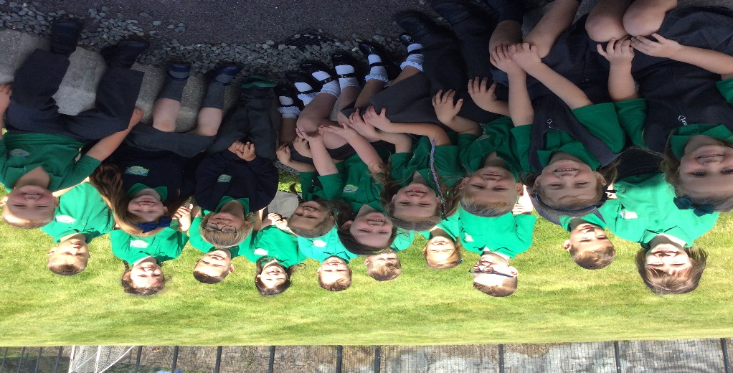
Fáilte go
Bunscoil Bheanna Boirche
Rang a 2
Dé Máirt 18 úMéan Fómhair 2018
Tuesday 18th September 2018

Slide 2
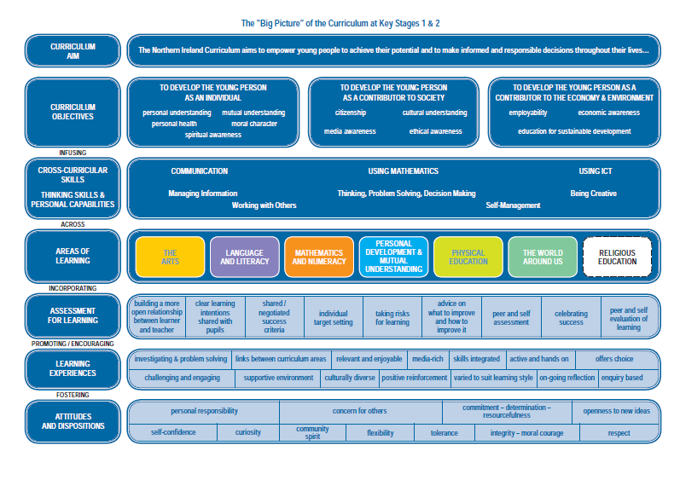

Slide 3
Curaclam (ar lean…)
Curriculum (continued…)
A significant proportion of the curriculum in Rang 1/2 is delivered through play-based learning. Children learn to problem solve, take turns, share, explain their methods and extend their vocabulary and communication skills through language rich, adult supervised/led play experiences. We cover real-life topics such as ‘People who help us’, ‘Birthdays’, ‘Castles’, ‘Transport’ etc., as well as covering seasons, festivals and celebrations throughout the world.
We are very well resourced with ICT equipment, with an average of 2 PCs, 1 laptop and an interactive whiteboard in each classroom.
Children have timetabled use of iPads to further develop ICT skills.
We are in inter-denominational school, and we follow ‘Living Learning Together’, a pastoral care programme which encourages personal development and mutual understanding of the world and the wider community.

Slide 4
Numeracy and Literacy in Rang 2
Numeracy
Collins scheme
Mental maths sessions
Collins number workbooks
Literacy
School scheme
The World Around Us - Geography, History, Science and Technology
NSPCC
‘Keeping safe project’ as part of our PDMU subject
healthy relationships my body being safe

Slide 5
Assessment in Foundation Stage
While there is no formal assessment in Rang 1 and Rang 2, children are observed on a daily basis by both the class teacher and classroom assistants. The information gained from these observations is used to plan future lessons.
‘During Years 1 and 2 ongoing assessment will be based mainly on teacher observation which will inform the learning programme for each child. Observations are a natural and essential part of good practice for teachers and classroom assistants. Well-planned, regular and skilful observations help teachers gain information about children's progress over time which ensures that all children's needs are being met.’
http://ccea.org.uk/curriculum/foundation_stage/assessment

Slide 6
Assessment in Foundation Stage
Every Friday in Rang 2, we will be doing a dictation based on that weeks phonics lessons.
We will complete a Collins Primary Maths assessment every half term. This will be based on the numeracy lessons that have been taught over the previous 6 weeks.

Slide 7
An Lá Scoile
The School Day
Class begins at 9 am. Children are supervised in the clós (playground) from 8.45 am, and parents can avail of our ‘Club Bricfeasta’ which will be available each morning from 8 – 9 am.
Breaktime is from 10.30-11.00am.
Lunchtime is from 12.15-1.00pm.
At Bunscoil Bheanna Boirche, we pride ourselves in our healthy eating policy. Our school dinners come from St.Malachy’s Primary School in Castlewellan and are of a high standard. It is recommended that pupils eat fruit, a yogurt or a small sandwich at break time. Water is always available, and school milk can be ordered termly. We discourage sugary/fizzy drinks, crisps, chocolates and sweets as these can impact on the children’s behaviour. We do not have any children with a nut allergy at present but we discourage bringing nuts to school.
Rang 1 and Rang 2 go home at 2.00pm.
Rang 4 – 7 go home at 3.00pm.
Rang 3 go home at 2.00pm until Christmas. From January onwards, Rang 3 go home at 3.00pm.

Slide 8
An Lá Scoile i Rang 2
The School Day in Rang 2
Am/Time | Imeacht/Activity
9.15-9.30 | Huff agus Puff, Self registration
9.30-10.00 | Whole class Literacy activities | Tionól every Friday
10.00-10.30 | Literacy tasks at tables | Phonics/ dictation every Friday
10.30-10.45 | Smailc/Snack in the classroom
10.45-11.00 | Break time outside
11.00- 11.30 | Whole class Numeracy activities | P.E –Tuesdays and Thursdays
11.30-12.00 | Numeracy Tasks at tables
12.00-12.15 | Am leabhar/ Book time

Slide 9
An Lá Scoile i Rang 2
The School Day in Rang 2
Am/Time | Imeacht/Activity
12.15-1.00 | Lunch/dinner in bialann followed by supervised outdoor play
1.00-1.25 | The World Around Us/ Talking and listening
1.25-1.55 | Súgradh – Structured play daily Monday-outdoor play (depending on weather)
1.55-2.00 | Homework folders given out and children go home from front door/go to after school clubs.

Slide 10
Éadaí Scoile
School Uniform
Our uniform consists of:
Navy sweatshirt embroidered with the school logo and motto (available from O’Hare’s Clothes Shop in Castlewellan, Co. Down);
Grey trousers, skirt or shorts;
Green polo shirt embroidered with the school logo and motto;
Navy school coat (optional);
Black shoes;
Girls may wear navy knee socks, navy tights or white ankle socks;
Girls may wear navy or green gingham dresses in the summer time;
During periods of cold weather girls may wear trousers.
P.E. uniform consists of:
Grey/ navy track bottoms, or grey/navy shorts;
Suitable trainers
School football jersey (optional) available to order
We have a school jersey which is OPTIONAL
NO JERSEYS OR BRANDED HOODIES
**PLEASE ENSURE ALL ITEMS OF CLOTHING ARE LABELLED CLEARLY!**

Slide 11
Tuismitheoirí - Parents
Our caring, family ethos at Bunscoil Bheanna Boirche means that we strongly value the importance of parental input in their child’s education, and we enjoy a wonderful level of parental participation and involvement in our school community here at Bunscoil Bheanna Boirche.
We strive to involve parents in the life of the school. Parents help with after-school activities and assist on school trips and events. Parents are employed in the school as lunchtime supervisors and classroom assistants. Parents are also involved in school fundraising, and we have a very active and vibrant Parents’ Support Group who regularly organise fundraising events and activities to help subsidise school trips and equipment.
We believe that happy children are more effective learners. Parents are always encouraged to discuss any concerns they may have either with the class teacher or with the principal. Our door is always open, and we pride ourselves here at Bunscoil Bheanna Boirche in our open and friendly relationships between teachers and parents.
In addition, BBB has a private Facebook Group which would regularly post photos and reminders of what’s been happening at school. Make sure to join!
App scoile ‘SchoolsNI’ a íoslódáíl- Download the School App for texts Feilire scoile ar www.bunscoilbb.com a úsáid go minic
Check the school calendar for class/school updates

Slide 12
Ag cuidiú le do pháiste
Supporting your child
As previously mentioned, whilst having Irish in the home is not a prerequisite to attend Bunscoil Bheanna Boirche, parents are strongly encouraged to avail of the many great Irish Language classes that are available in the area in order to be able to support their child’s learning.
In addition, support materials are always provided with homework’s for parents to use to help with pronunciation and meaning.
There are some fantastic websites to assist parents with Irish and support their child, such as:
www.abair.ie
www.tearma.ie
www.bbc.co.uk/northernireland/irish/blas
Remember, homework is a REVISION of work/topics covered in class, so pupils will be able to tell you what they are meant to do, and will take great joy in doing so!
There are some fantastic websites to assist parents with Irish and support their child, such as: www.abair.ie www.tearma.ie
www.bbc.co.uk/northernireland/irish/blas www.irishforparents.ie
We also recommend using the following apps if you have a tablet device at home:
Cód na Gaeilge, Sumdog, Cúla 4, Fuaim Ú, iMovie, Beebot, Scratch Jr Book Creator,
Green Screen
and we welcome any recommendations for good apps you may come across at home! Please send them in!

Slide 13
Ailéirge - Allergy
We have a pupil in the school with an allergy to eggs. We ask parents to ensure that pupils do not take ANY EGGS to school with them, either for break or for lunch. We greatly appreciate your cooperation with this matter.

Slide 14
Ceisteanna ar bith?
Any questions?

