Slide 1
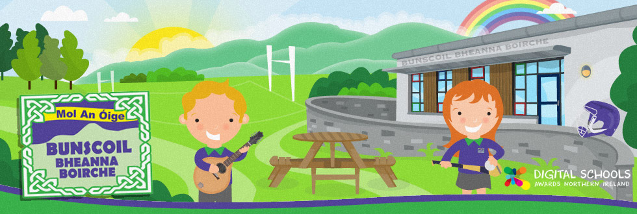
Fáilte go
Bunscoil Bheanna Boirche
Déardaoin 20ú Meán Fómhair 2017
Thursday 20th September 2018

Slide 2
Curaclam - Curriculum
There are three stages in Primary School:
Foundation Stage (Rang 1 and 2)
Key Stage 1 (Rang 3 and 4)
Key Stage 2 (Rang 5, 6 and 7)
We follow the Northern Ireland Curriculum: Literacy, Numeracy, The World Around Us, The Arts (Art & Design, Music and Drama), P.E., Personal Development and Mutual Understanding (PDMU), Religious Education, ICT.
NSPCC Programme- Keeping safe
Healthy Relationships.
My Body.
Being Safe.
www.nspcc.org.uk

Slide 3
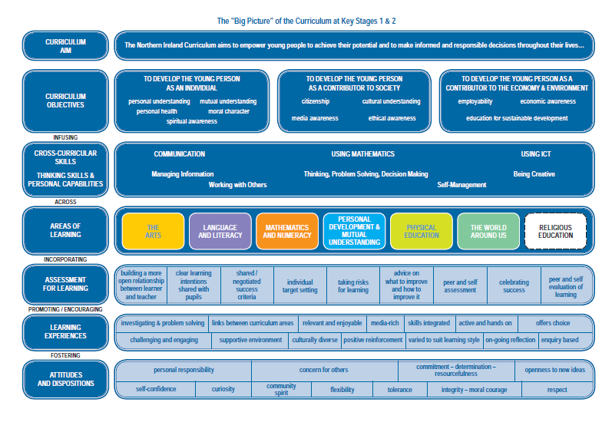

Slide 4
Curaclam (ar lean…)
Curriculum (continued…)
A significant proportion of the curriculum in Rang 4/5 is delivered through topic-based learning. Children learn to problem solve, investigate ideas, create projects, cooperate with others, explain their findings and extend their vocabulary and communication skills through a variety of topics such as ‘All about me’, ‘Healthy eating’ ‘history of Castlewellan’, ‘extreme weather’ and ‘Rainforests’.
We are very well resourced with ICT equipment, with an average of 2 PCs, 1 laptop and an interactive whiteboard in each classroom, and a set of iPads which are timetabled and shared throughout the school.
We are in inter-denominational school, and we follow ‘Living Learning Together’, a pastoral care programme which encourages personal development and mutual understanding of the world and the wider community. We also prepare children for the Catholic sacraments if their parents so wish, following the ‘Beo Go Deo’ Catholic Education Series. We also cater for children who do not wish to participate in R.E.

Slide 5
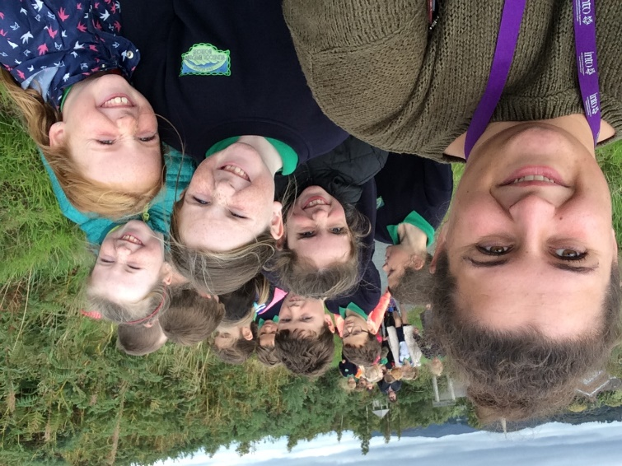
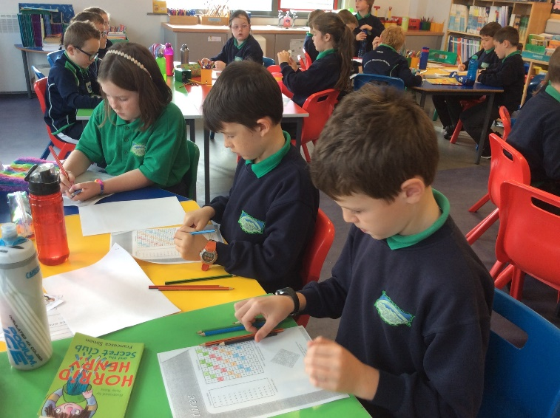
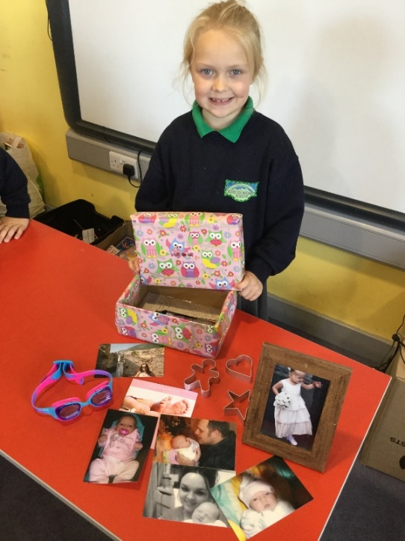
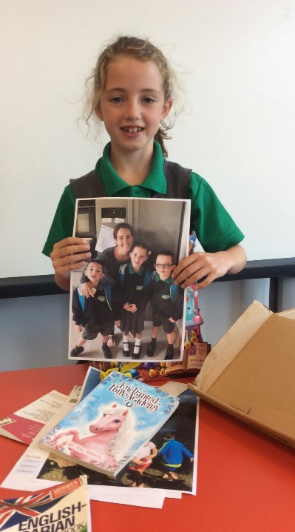
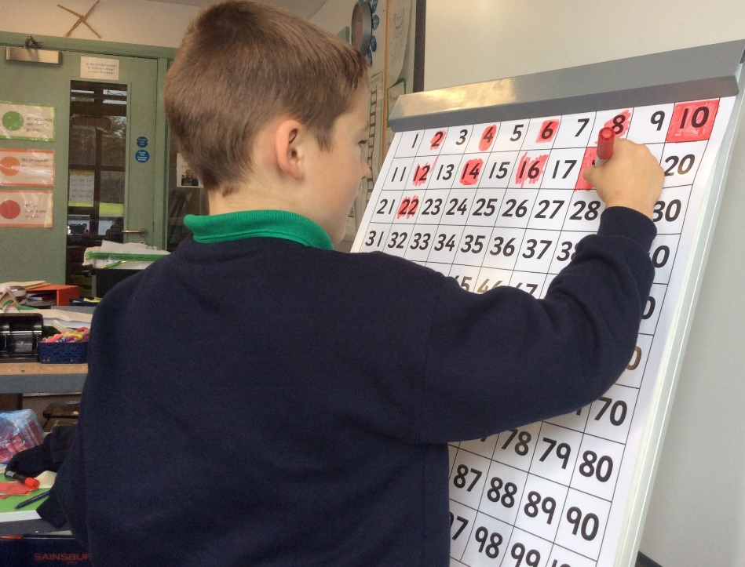
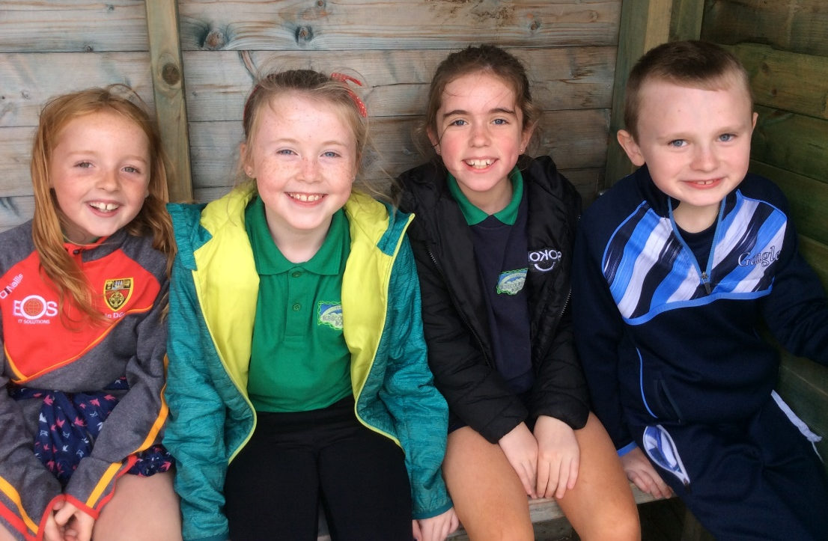

Slide 6
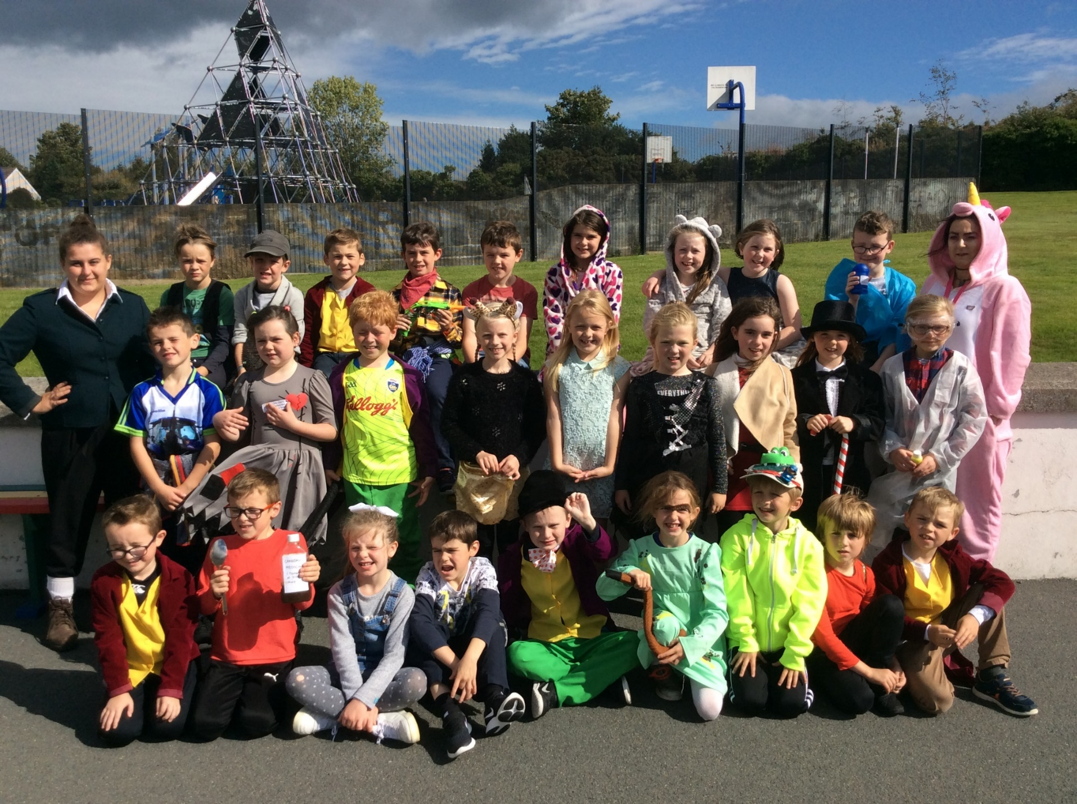

Slide 7
Litearthacht - Literacy
TALKING & LISTENING
TALKING & LISTENING
This is very important. Children must learn to listen when others are talking, as this forms the basis of all other subjects
Encourage your child to listen to you at home, without interrupting and to take turns
READING
Shared books – carried out in school from the reading scheme and big books. Talking & listening, grammar and comprehension are also taught through this scheme
Home readers are sent home, to be read with parents. These are easier books, to encourage reading.
Children have access to class library books and we also encourage parents to permit their children to join the local library.
We are also beginning the Accelerated Reading scheme this year. We have some books in school but more can be accessed through the local library. Your child has a unique log on and can carry out quizzes in school on the books they have read.

Slide 8
Litearthacht - Literacy
PHONICS & SPELLINGS
  Phonics play a very important part in reading and spellings
  Pupils will learn the different sounds and how to combine them to make words
  Pupils focus on a different stage or principal of phonics blending each week
  Phonics comprehension is checked on Fridays through a short dictation test.
WRITING
Correct letter formation and cursive writing
Grammar and punctuation
Poetry and letter writing
Different forms of writing are taught throughout the year eg. recount, instructional, narrative, etc.
Presentation of this work is very important

Slide 9
Uimhirtheacht / Numeracy
The month of September is spent in basic revision
Pupils will be introduced to numbers up to 10,000
The four rules of adding, subtracting, multiplying and dividing
Money – it is helpful to let children handle money at home
Shape and space – 2D and 3D shapes
Measurement – length, weight, capacity, volume and time
Data handling –drawing and interpreting graphs
Mental maths – various games / exercises in class

Slide 10
Measúnú - Assessment
A key question parents often ask is ‘how will my child be assessed?’
Bunscoil Bheanna Boirche assesses pupils in the same ways as pupils are assessed in any other primary school in Northern Ireland – Irish or English medium.
In accordance to the NI Curriculum, in Years 1 – 7, teachers must assess your child’s learning.
In Rang 1 & 2, this predominantly takes the form of on going individual classroom observations. However, in Rang 1 & 2, pupils are also assessed on a 6 – weekly basis on their key literacy and numeracy skills/targets, albeit in a very informal style, such as structured games and 1:1 activities.
In Rang 3 - 7, pupils undergo standardised tests in the summer term in English, Irish and Maths, which give a more formal indication of progress. These scores are then analysed by the teachers, and used to plan the future teaching and learning of our pupils.
Every autumn, 1:1 parent-teacher meetings are help to update you on your child’s progress and to suggest areas to help support your child in the home environment.
At the end of each school year, you will receive a written report from your child’s teacher. This will describe your child’s progress in every aspect of the curriculum.

Slide 11
Spóirt
Key Stage 2 pupils play Gaelic football, hurling and soccer for the school in local inter-school competitions.
Upper Key Stage 2 pupils travel to Down Leisure Centre in Downpatrick every spring for swimming lessons.
Structured weekly PE lessons are also taught, in which teachers follow a movement and athletics scheme which ensures continuity and progression of core skills and competences.

Slide 12
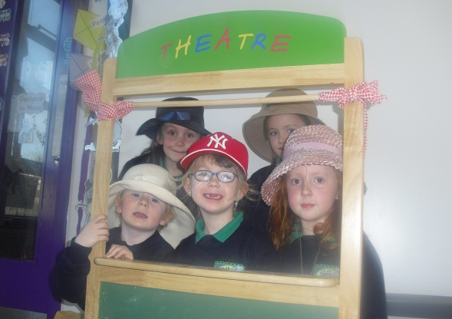
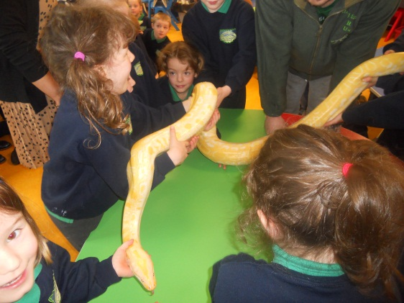
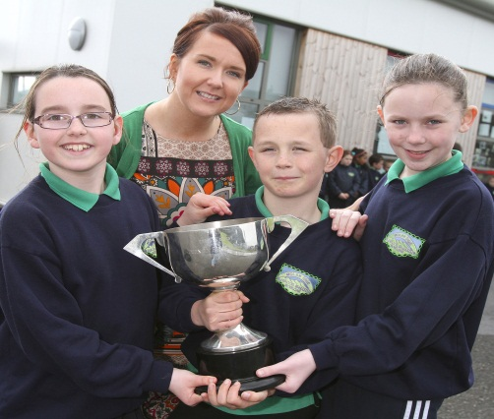
Imeachtaí Seach-churaclaim
Extra-curricular activities
Club Bricfeasta – breakfast club from 8 – 8.45 am
Homework Club Mon-Thurs from 2-4pm daily and costs £2
Sport with Marty every Friday- paid in advance.
School Council and Eco-School committee
Summer Scheme - having fun and speaking Irish in July
Regular school trips, walks and outings – Forest Schools

Slide 13
An Lá Scoile
The School Day
Class begins at 9.00am. Children are supervised in the clós (playground) from 8.45am, and parents can avail of our ‘Club Bricfeasta’ which will be available each morning from 8 – 8.45 am.
Break time is from 10.35-11.00am.
Lunchtime is from 12.15-1.00pm.
At Bunscoil Bheanna Boirche, we pride ourselves in our healthy eating policy. Our school dinners come from St.Malachy’s Primary School in Castlewellan and are of a high standard. It is recommended that pupils eat fruit, a yogurt or a small sandwich at break time. Water is always available, and school milk can be ordered termly. We discourage sugary/fizzy drinks, crisps, chocolates and sweets as these can impact on the children’s behaviour. We do not have any children with a nut allergy at present but we discourage bringing nuts to school.
We have a fruit trolley which comes round each class at break time every day and your child can purchase a piece of fruit for 40p
Rang 1 and Rang 2 go home at 2.00pm.
Rang 4 – 7 go home at 3.00pm.
Rang 3 go home at 2.00pm until Christmas. From January onwards, Rang 3 go home at 3.00pm.
Our after-school club runs from 2 – 4pm daily in the school bialann.

Slide 14
Éide Scoile
School Uniform
Our uniform consists of:
Navy sweatshirt embroidered with the school logo and motto (available from O’Hare’s Clothes Shop in Castlewellan, Co. Down);
Grey trousers, skirt or shorts;
Green polo shirt embroidered with the school logo and motto;
Navy school coat (optional);
Black shoes;
Girls may wear navy knee socks, navy tights or white ankle socks;
Girls may wear navy or green gingham dresses in the summer time;
During periods of cold weather, girls may wear trousers.
P.E. uniform consists of:
Grey/ navy track bottoms, or grey/navy shorts;
Suitable trainers
Green polo shirt embroidered with the school logo and motto
We have a school jersey which is OPTIONAL
**PLEASE ENSURE ALL ITEMS OF CLOTHING ARE LABELLED CLEARLY!**

Slide 15

Geansaí Peile
Our school jersey is not compulsory. Children can wear it for PE in school, and may also wear it to school on other sporting occasions, such as Sports Day. The jersey costs £24.50 and half zip costs £28.

Slide 16
Poncúlacht - Punctuality
Punctuality is extremely important here at Bunscoil Bheanna Boirche. School begins at 9.00am. Register is taken immediately, and anyone who arrives after 9.15am is marked in as late. Anyone who arrives after 9.30am is marked absent for the morning (unless attending an appointment, in which case the teacher should be informed). If attendance falls below 85% the Education Welfare Officer from the Education Authority will investigate absences.

Slide 17
Tuismitheoirí - Parents
Our caring, family ethos at Bunscoil Bheanna Boirche means that we strongly value the importance of parental input in their child’s education, and we enjoy a wonderful level of parental participation and involvement in our school community here at Bunscoil Bheanna Boirche.
We strive to involve parents in the life of the school. Parents help with breakfast club, after-school activities and assist on school trips and events. Parents are employed in the school as lunchtime supervisors and classroom assistants. Parents are also involved in school fundraising, and we have a very active and vibrant Parents’ Support Group who regularly organise fundraising events and activities to help subsidise school trips and equipment.
We believe that happy children are more effective learners. Parents are always encouraged to discuss any concerns they may have either with the class teacher or with the principal. Our door is always open, and we pride ourselves here at Bunscoil Bheanna Boirche in our open and friendly relationships between teachers and parents.
Every class now have a page of their own on the Bunscoil Bheanna Boirche website. The class teacher will regularly post pictures of what’s going on in the class, so you can stay up to date. You can receive the newsletter as an email, just give your email address to Aingeal or in to the school office.
In addition, BBB has a private Facebook Group which would regularly post photos and reminders of what’s been happening at school. Make sure to join!

Slide 18
Cairde
Our Parent Support Group
We have a very active and dedicated Parent Support Group called ‘Cairde’ who regularly arrange activities such as fundraiser events and family fun days.
Their fundraising goes towards subsidising buses for school trips to reduce the cost for parents, purchasing class iPads, class reading books, developing our outdoor play area etc.
They are an integral part of Bunscoil Bheanna Boirche and are always keen for new members to join in and help in whatever small way they can. Keep up to date on the Facebook Group or speak to one of the parent members if you think you could spare a few hours a month or have any great ideas to share.

Slide 19
Polasaithe Scoile
School Policies
Child Protection Policy was given out in the last week of August.
All of our other school policies are available to view on the school website www.bunscoilbb.com or from the school office by appointment with the principal

Slide 20
Ag cuidiú le do pháiste
Supporting your child
A great way to help your child is to encourage them to develop their own independence through taking responsibility for organising their own PE kit to bring on the correct days, paying their own dinner money, looking after their coats jumpers, etc. (please label these), remembering to take home their homework folder and to bring it back to school, keeping their homework diary up to date, etc.
As previously mentioned, whilst having Irish in the home is not a prerequisite to attend Bunscoil Bheanna Boirche, parents are strongly encouraged to avail of the many great Irish Language classes that are available in the area in order to be able to support their child’s learning.
Remember, homework is a REVISION of work/topics covered in class, so pupils will be able to tell YOU what they are meant to do, and will take great joy in doing so!

Slide 21
Ag cuidiú le do pháiste
Supporting your child
There are some fantastic websites to assist parents with Irish and support their child, such as:
www.abair.ie
www.tearma.ie
www.bbc.co.uk/northernireland/irish/blas
www.irishforparents.ie
and many more…
We also recommend using the following apps if you have a tablet device at home:
Reading Eggs, Mathletics, Sumdog, Cúla 4, Fuaim Ú, iMovie, Beebot, Scratch Jr, Book Creator
and we welcome any recommendations for good apps you may come across at home! Please send them in!

Slide 22
Ceisteanna ar bith?
Any questions?

