Slide 1
Cruinniú Curaclaim
Curriculum Meeting
Bunscoil Bheanna Boirche
Rang 6
Múinteoir Caoimhe

Slide 2
Dialann an lae Daily Routine
9.00.9.10am - Registration
9.10-9.30am - Tasc na maidine/Morning Task
9.30-9.50am - Phonics (Gaeilge – Monday and Wednesday. Béarla – Tuesday and Thursday.)
9.50-10.30am - Gaeilge – Grammar/Comprehension/Writing genre
10.30-11.00am – Breaktime/ Novel (Read aloud)
11.00-11.20am - Mental maths activities
11.20-12.00pm - Numeracy
12.00-1.00pm - Lunch
1.00-1.20pm - Accelerated Reading novels & quizzes
1.20- 1.40pm – Reading lessons (Gaeilge – Monday. Béarla – Wednesday.)
1.40-2.20pm – English - grammar & punctuation/work based on novel/ comprehension / writing genre/ writing based on WAU topic
2.20- 2.40pm - W.A.U (topic work)/ Art/ Mindfulness/ Music/ Personal Development
3.00 Hometime

Slide 3
Curriculum
We follow the Northern Ireland Curriculum: Literacy, Numeracy, The World Around us, The Arts (Art and Design, Music and Drama), P.E., Personal Development and Mutual Understanding and ICT.
A significant proportion of the Curriculum in Rang 6 is delivered through Topic-based learning. Children learn to problem solve, investigate ideas, create projects, cooperate with others, explain their findings and extend their vocabulary and communication skills through a variety of Topics. We are currently working on our topic ‘The Titanic’.
We are very well resourced with ICT equipment, with an interactive whiteboard in our classroom and have access to 4 computers and 6 ipads when required.

Slide 4
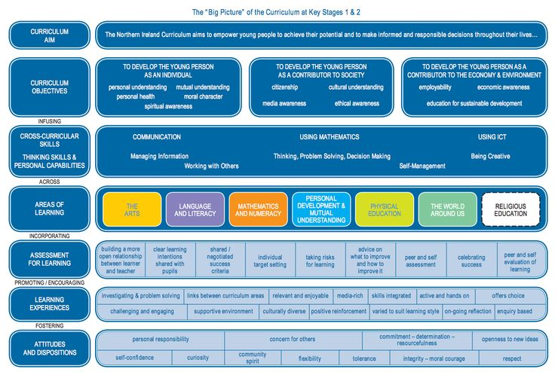

Slide 5
Litearthacht – Literacy
Literacy will be taught through both English and Irish.
Talking and Listening:
This is a very important strand of the Literacy programme. Pupils are expected to listen to others respectfully & speak clearly in their turn. There will be many opportunities to develop their communication skills through class discussions, debates and drama & role-playing relating to topics from across the curriculum.
Reading
Reading will be celebrated both as a form of enjoyment and a vital life skill in Rang a Sé. Reading homework should be given as much time & attention as written work.
Home readers will be sent home weekly to be read with parents. These are easier books to encourage reading. The children will complete short activities based on these readers for homework, which will help aid their comprehension of what they have read in class.
Children will have access to class library books and a wide range of texts based on our topic (non-fiction books, poetry anthologies, graphic novels etc.) We encourage parents to have their children join the local library and to engage with their child in positive conversations about the material that they are reading for pleasure.

Slide 6
Litearthacht/ Literacy Continued
Phonics and spellings
Phonics play a very important part in reading and spellings, especially in the Irish language, as the children continue to navigate the sounds and spelling system of their second language.
We follow the Cód na Gaeilge programme during Fónaic na Gaeilge lessons. The children will investigate a new sound each week and will complete a spelling test every Friday to assess their understanding of this sound.
Writing
The children will be introduced to a new genre of writing each half term (eg, recount, instructional, narrative etc.). We are currently focusing on identifying the features of and writing our own newspaper articles.
In Rang a Sé, we will place a particular focus on producing high quality pieces of writing. We will focus on the 5 stages of the writing process (collating ideas, planning, drafting, redrafting and editing and publishing) and the children will have plenty of opportunities to share their writing with suitable audiences.
The “2 stars & a wish” system will be used as a positive approach to peer and self-assessment, to celebrate the pupils’ achievements and encourage improvement in their written work.

Slide 7
Uimhearthacht- Numeracy
The month of September is spent revising the four main operations: adding, subtracting, multiplying and dividing.
The children will be expected to plan and organise their work, select appropriate equipment, develop their use of mathematical language, analyse their work and present their work and findings clearly.
Throughout Rang a Sé the children will develop their understanding of number, shape and space and data handling:
Number- Increase competence in dealing with whole numbers and deepen knowledge of place value, develop knowledge of fractions and percentages, understanding of negative numbers, recognise pattern and relationships in number, multiplication tables, develop ability in using four main operations and show understanding of maths in real-life problems
Shape and Shape – 2D/ 3D shapes- Construct, describe and analyse shapes and awareness of angle, symmetry and co-ordinates
Data Handling- measurement- Length, weight, capacity, volume and time- Ability to convert metric units of measurement and understand the concept of scale. Develop competence in dealing with time, ability to read and understand data stored in a variety of ways, collection and classification, presentation, interpreting of data and probability.

Slide 8
Uimhearthacht- Numeracy
A strong foundation in mental maths will benefit the children greatly as they begin to face more complicated concepts in Rang a Sé. We will spend 20 minutes each day engaging in mental maths games and exercises to consolidate the children’s understanding of number. A huge emphasis is placed on the learning of multiplication tables in R6, as a strong foundation in these number facts allows the child to complete harder calculations with greater ease and efficiency.
These activities will include:
Paired games and group work
Investigating number and patterns
Word problems
Open ended maths tasks
Practical games
Drawing and constructing shapes
Investigating 2D/3D shapes
Reading different sources of data
Presenting information and their meanings
Undertaking surveys and collecting their own data

Slide 9
An Domhan Thart Orainn/ The World Around Us
In Rang a Sé we will be focusing on five main topics during ‘An Domhan Thart Orainn’ lessons. Cross-curricular learning will take place during these lessons, allowing the children to develop their language skills and mathematical skills in a fun and engaging manner.
We will be exploring the following topics throughout the year:
The Titanic
Climate Change
Our Culture (The history of the Irish Language, the history of our music, sporting and dancing traditions in Ireland etc.)
Native nature of Ireland (We will investigate our native species of animals and trees (red kites, red squirrels etc.) and explore the efforts to preserve them in our local area.)
The Great Famine

Slide 10
Physical Education/ Corpoideachas
Physical Education; Structured weekly PE lessons are taught, in which teachers follow a movement and athletics scheme which ensures continuity and progression of core skills and competences. These include:
Co-ordination
Balance
Self control
Body awareness
Handling equipment
Spatial awareness
Co-operation
Instructions
Direction
Speed
Accuracy.
In term 1 the children will participate in athletic sessions every Monday. We will also have a PE lesson every Wednesday. The children are expected to wear their PE uniforms on these days.

Slide 11
Na hEalaíona/ The Arts
Drama | Music | Art
Role-play Topic-based drama activities Imaginative play Use / designing of props | Traditional Irish songs Modern Irish songs Topic-based songs Songs from other countries | Line, shape, colour, pattern, etc Drawing, sketching, painting, cutting, designing, etc Studying famous artists and their work

Slide 12
Measúnú- Assessment
How is my child assessed at school?
Bunscoil Bheanna Boirche assesses pupils in the same ways as pupils are assessed in any other primary school in Northern Ireland- Irish or English Medium.
In accordance with the NI Curriculum, in Years 1-7, teachers must assess your child’s learning.
Continuous assessment is completed regularly in the classroom, through assessing your child’s written work, participation in class discussions and tests on a Friday. However in Rang 6 pupils undergo standardised tests in the summer term in English, Irish and Maths which give a more formal indication of progress. These scores are then analysed by the teachers, and used to plan the future teaching and learning of our pupils.
Parent-teacher meetings will help update you on your child’s progress and will give you the opportunity to learn about how you can help your child in the home environment.
At the end of each school year, you will receive a written report from your child’s teacher. This will describe your child’s progress in every aspect of the curriculum.

Slide 13
Imeachtaí Seach- Churaclaim- Extra Curricular activities
Club Bricfeasta- Breakfast club from 8-8.45am
Club iarscoile- The ‘After-School Club’ takes place on a Monday- Thursday after school - 3pm-4pm
The club will offer a range of different activities for the children ie. gardening, use of ICT, games, homework, baking etc. The cost for both clubs is £3.

Slide 14
Tuismitheoirí- Parents/Guardians
Our caring, family ethos at Bunscoil Bheanna Boirche means that we strongly value the importance of parental input in their child’s education.
We believe that happy children are more effective learners. Parents are always encouraged to discuss any concerns they may have either with the class teacher or with the principal. Our door is always open, and we pride ourselves here at Bunscoil Bheanna Boirche in our open and friendly relationships between teachers and parents.

Slide 15
Aip Scoile
School App
As we are an award winning Eco School, we aim to use as little paper as possible. Therefore, we send out important messages and information via our Schools NI app.
Parents are asked to download it ASAP, if you haven’t done so already. Please select Bunscoil Bheanna Boirche as your favourite school, and ensure that notifications are enabled and that you check the app regularly. We also ask parents to visit our website to keep up to date with what is happening in our school, for the school dinner menu etc...
Our app is available on both Android and Apple devices. Simply visit our school website where you will be prompted to download the app for free. www.bunscoilbb.com

Slide 16
Safer Schools NI App
We strongly recommend every family downloads the Safer Schools NI App, an online platform funded by DENI to support parents ensure internet use at home is safe.
Keeps you up to date with the current online trends, threats, and risks to your child. This information is sent directly to your device!
Delivers the information you need to know on social media and gaming platforms, helping you understand the latest buzzwords and how to set privacy and parental settings on platforms like Among Us, Minecraft and TikTok.
Offers expert guidance to help you navigate important issues such as bullying, mental health and healthy relationships. Giving you practical tips on how to approach these conversations with your children.
The Online Safety section will signpost you to help and support where you need it when you need it – it's in your pocket!

Slide 17
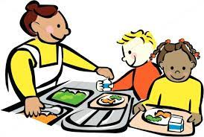
Dinner choices
This year a change has been made to our dinner menu. On given days the children are now given a choice between two meals. Please ensure that your child has made their choice before they come to school in their mornings. The current dinner menu has already been sent out on the School App and is available to view on the school website.

Slide 18
Ag cuidiú le do pháiste- Supporting your child
A great way to help your child is to encourage them to develop their own independence. In Rang a Sé the children should be taking responsibility for their own possessions and ownership of their own learning journey.
You can do the following to help your child:
Ensure that they are wearing the appropriate PE gear on their PE days (Tuesdays and Wednesdays)
Encourage them to look after their own belongings (coats, jumpers etc.) Please label these.
Encourage them to take home and return their homework folders
Take an interest in their work: ask them about their homework, reading books/novels or about what topics they are studying in school.
Sign their tables and spelling book weekly.
Encourage a healthy diet and lifestyle. (The school has a healthy break policy in line with the SOS programme – only fruit, vegetables, milk or water is permitted.
There are some fantastic websites to assist parents with their child’s learning at home. These include;
www.tearma.ie
www.focloir.ie
www.topmarks.com
www.sumdog.com
Seomra Nuachta (through C2k)

Slide 19
Corás Obair Bhaile
The children will be given their homework each Monday and will hand this in to be corrected each Friday. The homework will follow the following routine:
. Monday – Reading task based on Irish reading book.
. Tuesday – Maths task based on the topic covered in the previous week.
. Wednesday – Reading task based on English reading book.
. Thursday – Times tables Sumdog challenge.
On top of this the children are encouraged to practise their spellings and ‘Táblaí na seachtaine’ each night.
Spellings and Times Tables books should be signed weekly.

Slide 20
Tréadchúram/ Pastoral Care
Your child’s emotional well-being is as important to us as their academic development. We in the Rang 6 classroom of Bunscoil Bheanna Boirche will be partaking in many activities/events to cover this area e.g.
· Reward/Merit system - Dojos (linked to class rules)
-Whole class rewards
- Individual – Dalta & Gaeilgeoir na Seachtaine, Matamaiticeoir na Míosa, etc.
· Circle Time; discussions and role plays on friendships, emotions, bullying, sharing, empathy, etc
· “Maireachtáil foghlaim le chéile” & NSPCC “Keeping Safe” cover many areas of growing up, our families, relationships, respecting ourselves & others, etc
·

Slide 21
Go raibh míle maith agaibh

